Slide 1
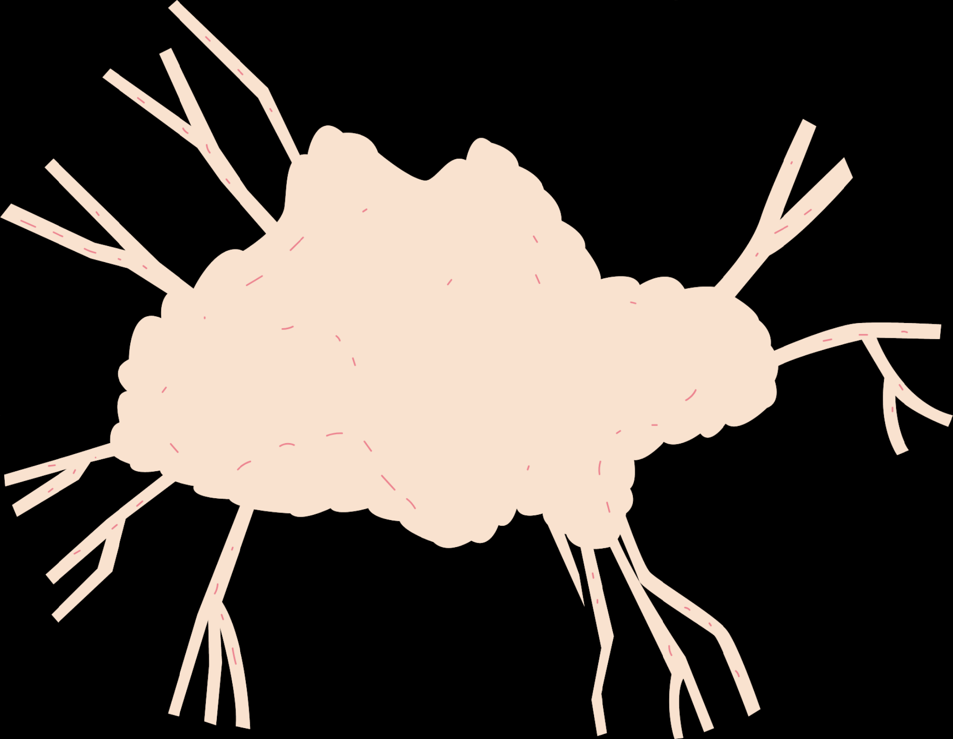
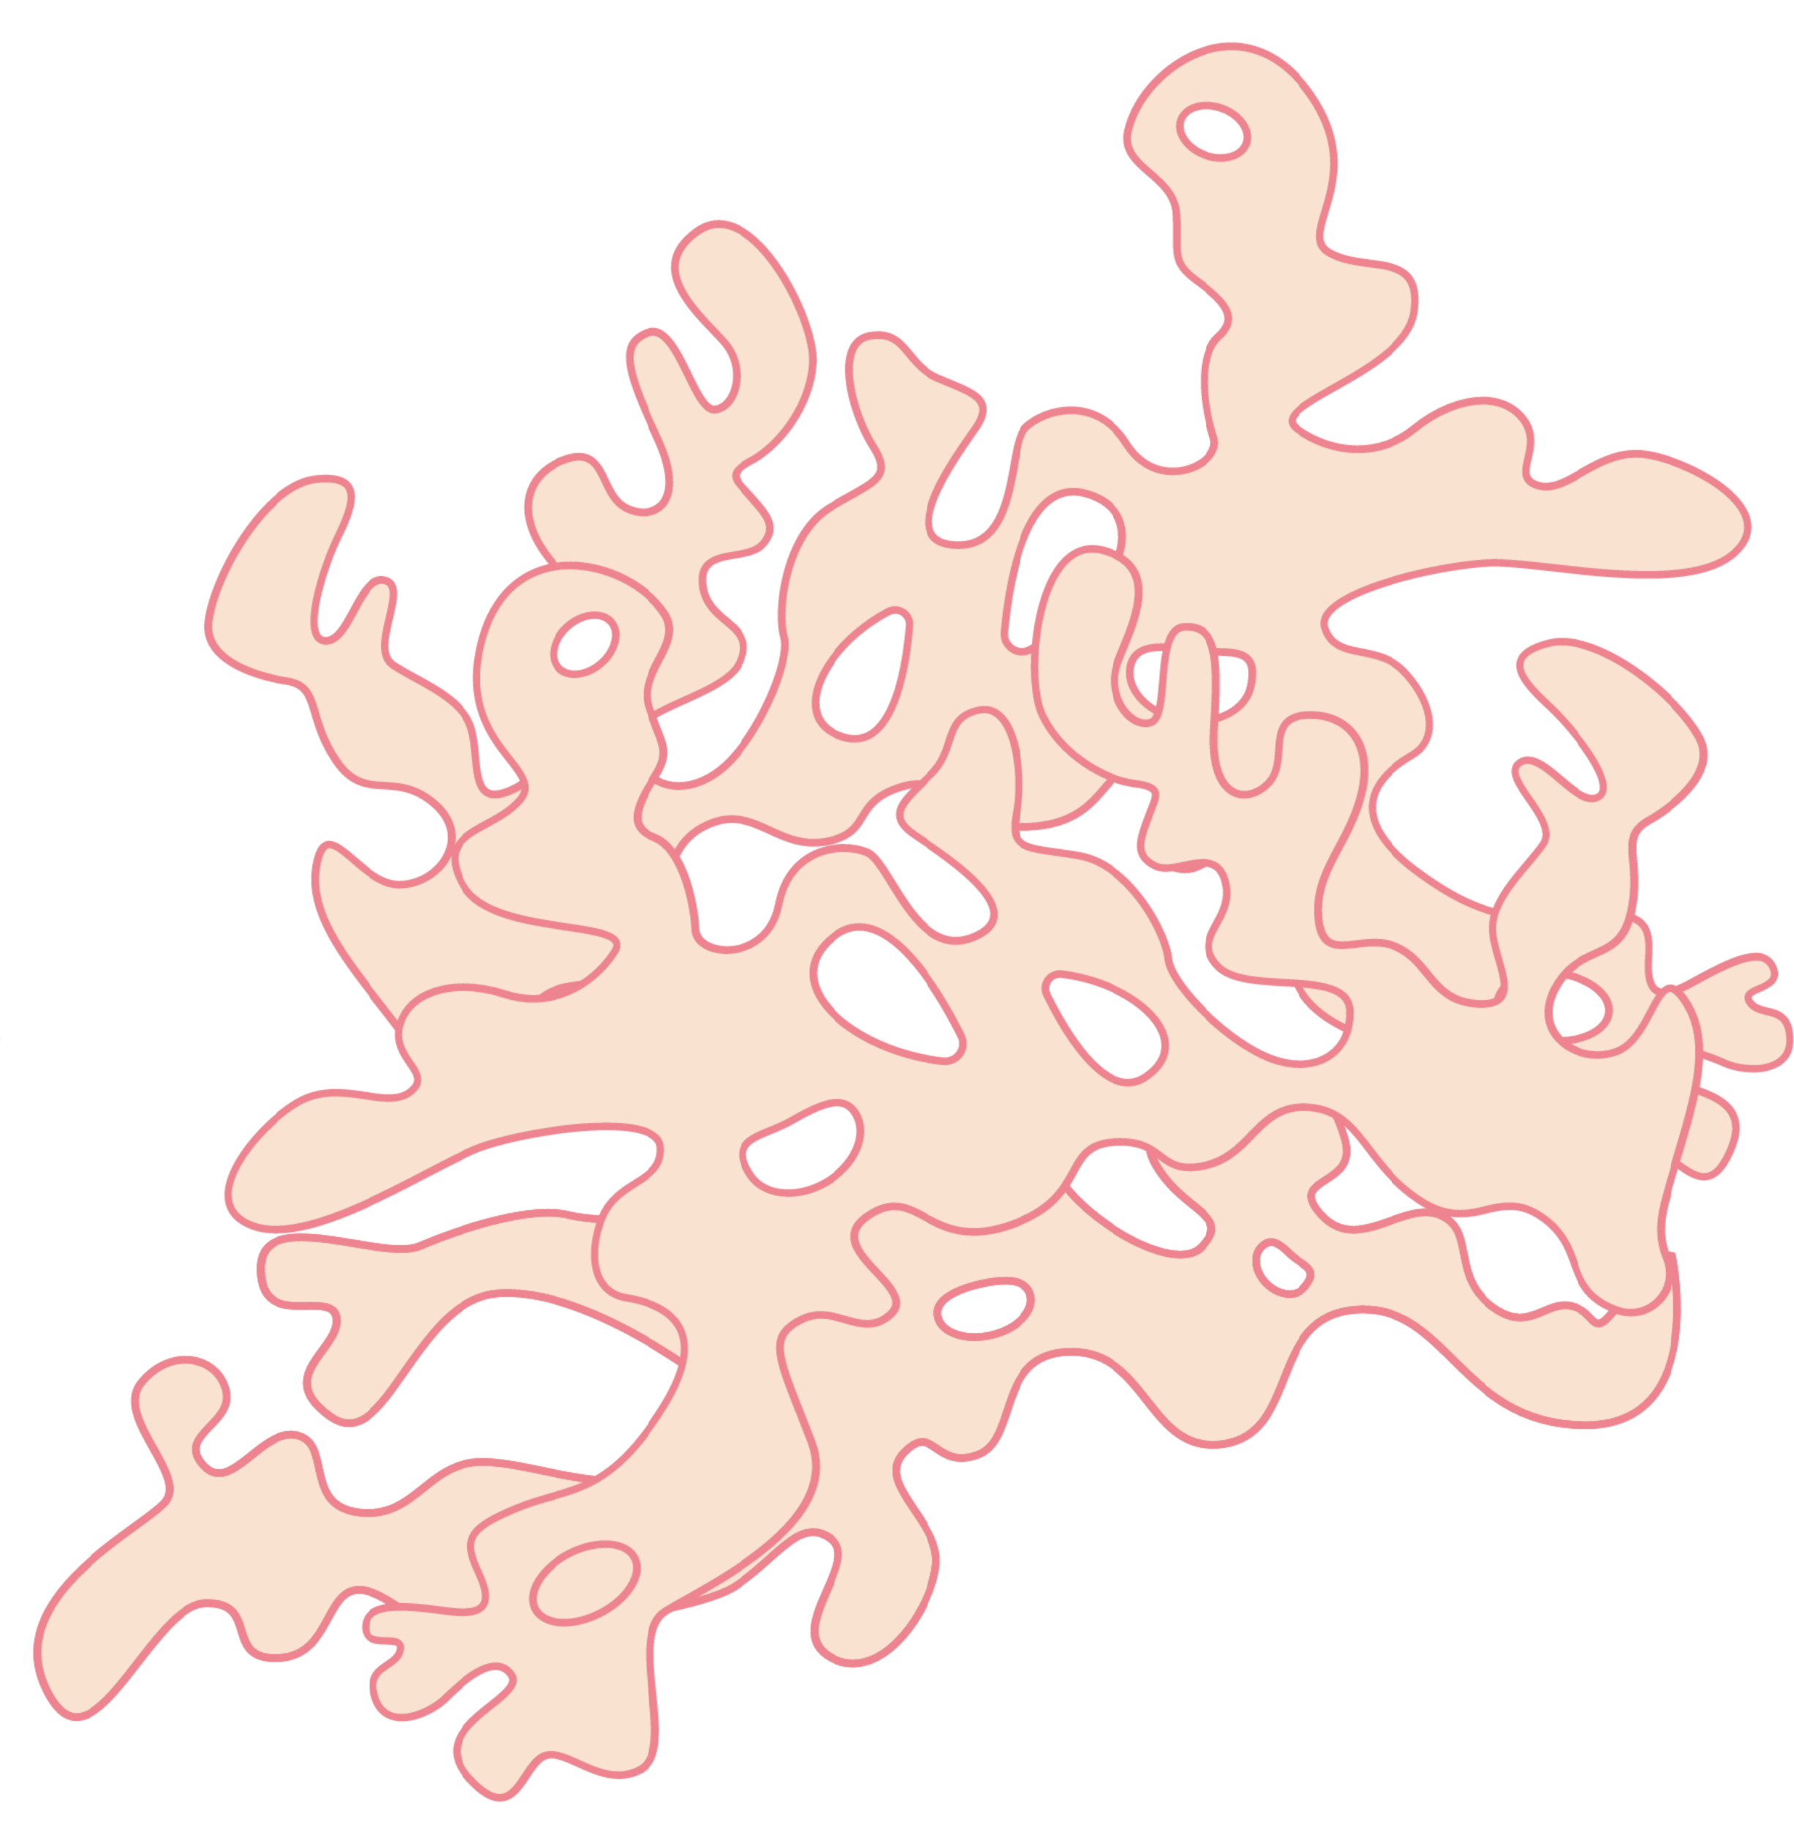


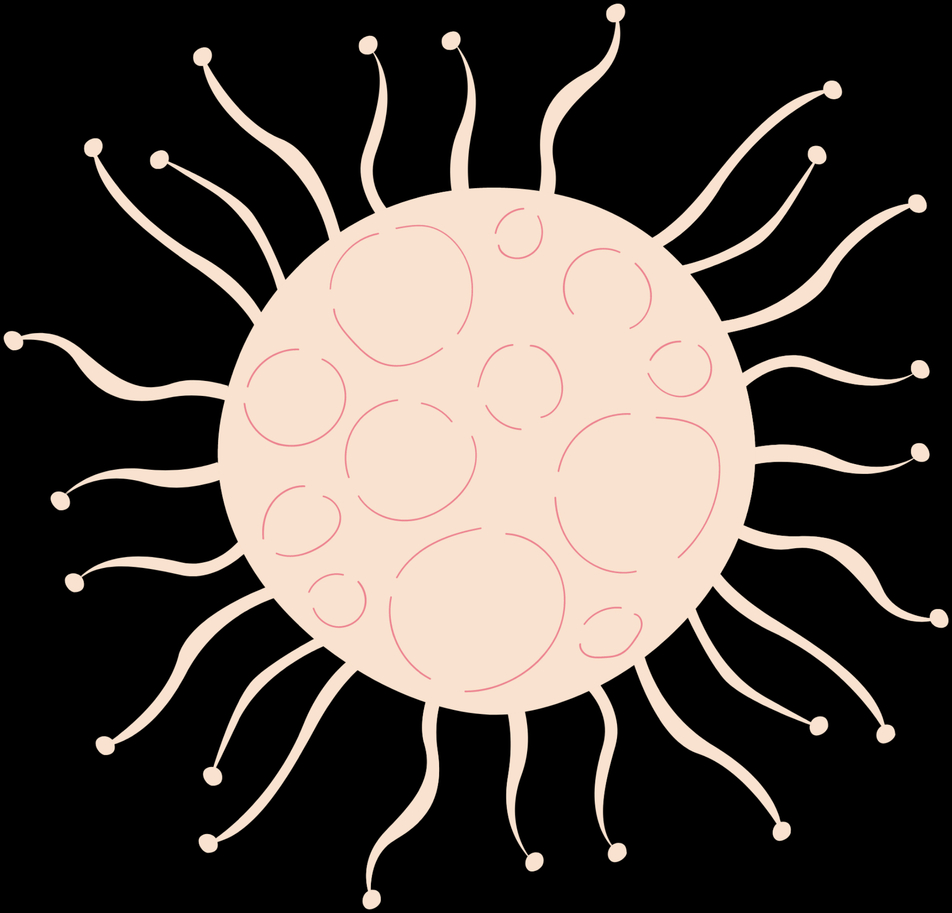
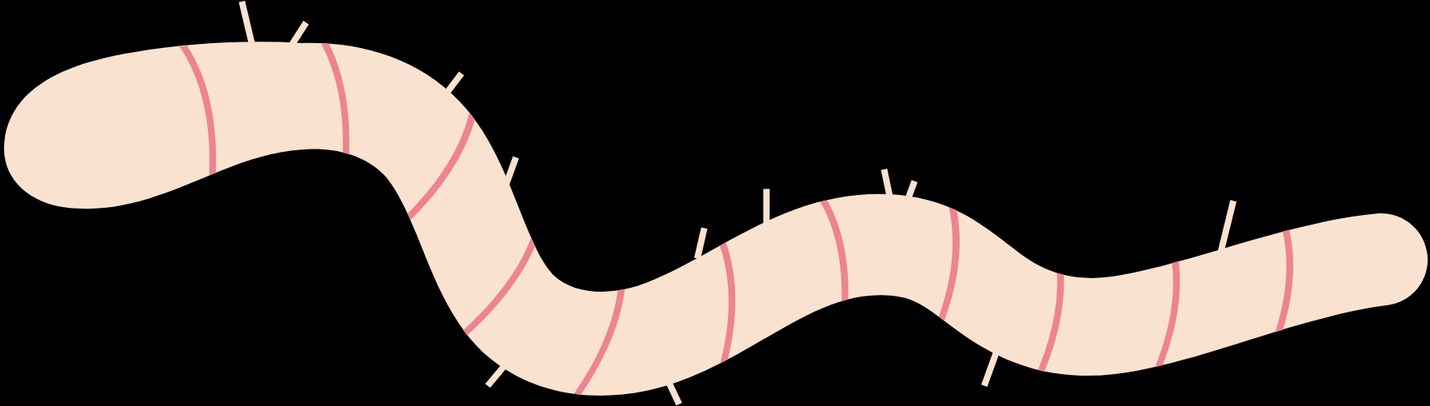
PHYLUM BACTERIODETES
By Taccana Patriz Yu Diet

Slide 2
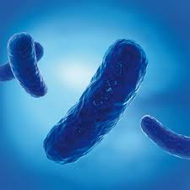
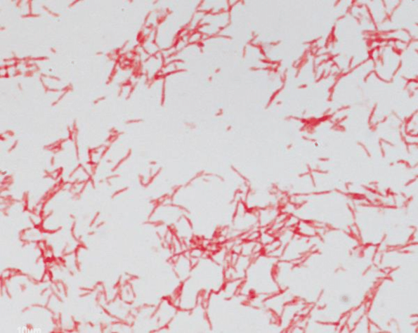
Introduction to Phylum Bacteroidetes
Is a group of bacteria that are primarily found in the gut of humans and other animals, as well as in soil and marine environments.
Bacteroidetes is a diverse phylum of Gram-negative, non-spore-forming, anaerobic, rod-shaped bacteria.
Well-known genera with Bacteriodetes include Bacteroides and Prevotella.

Slide 3
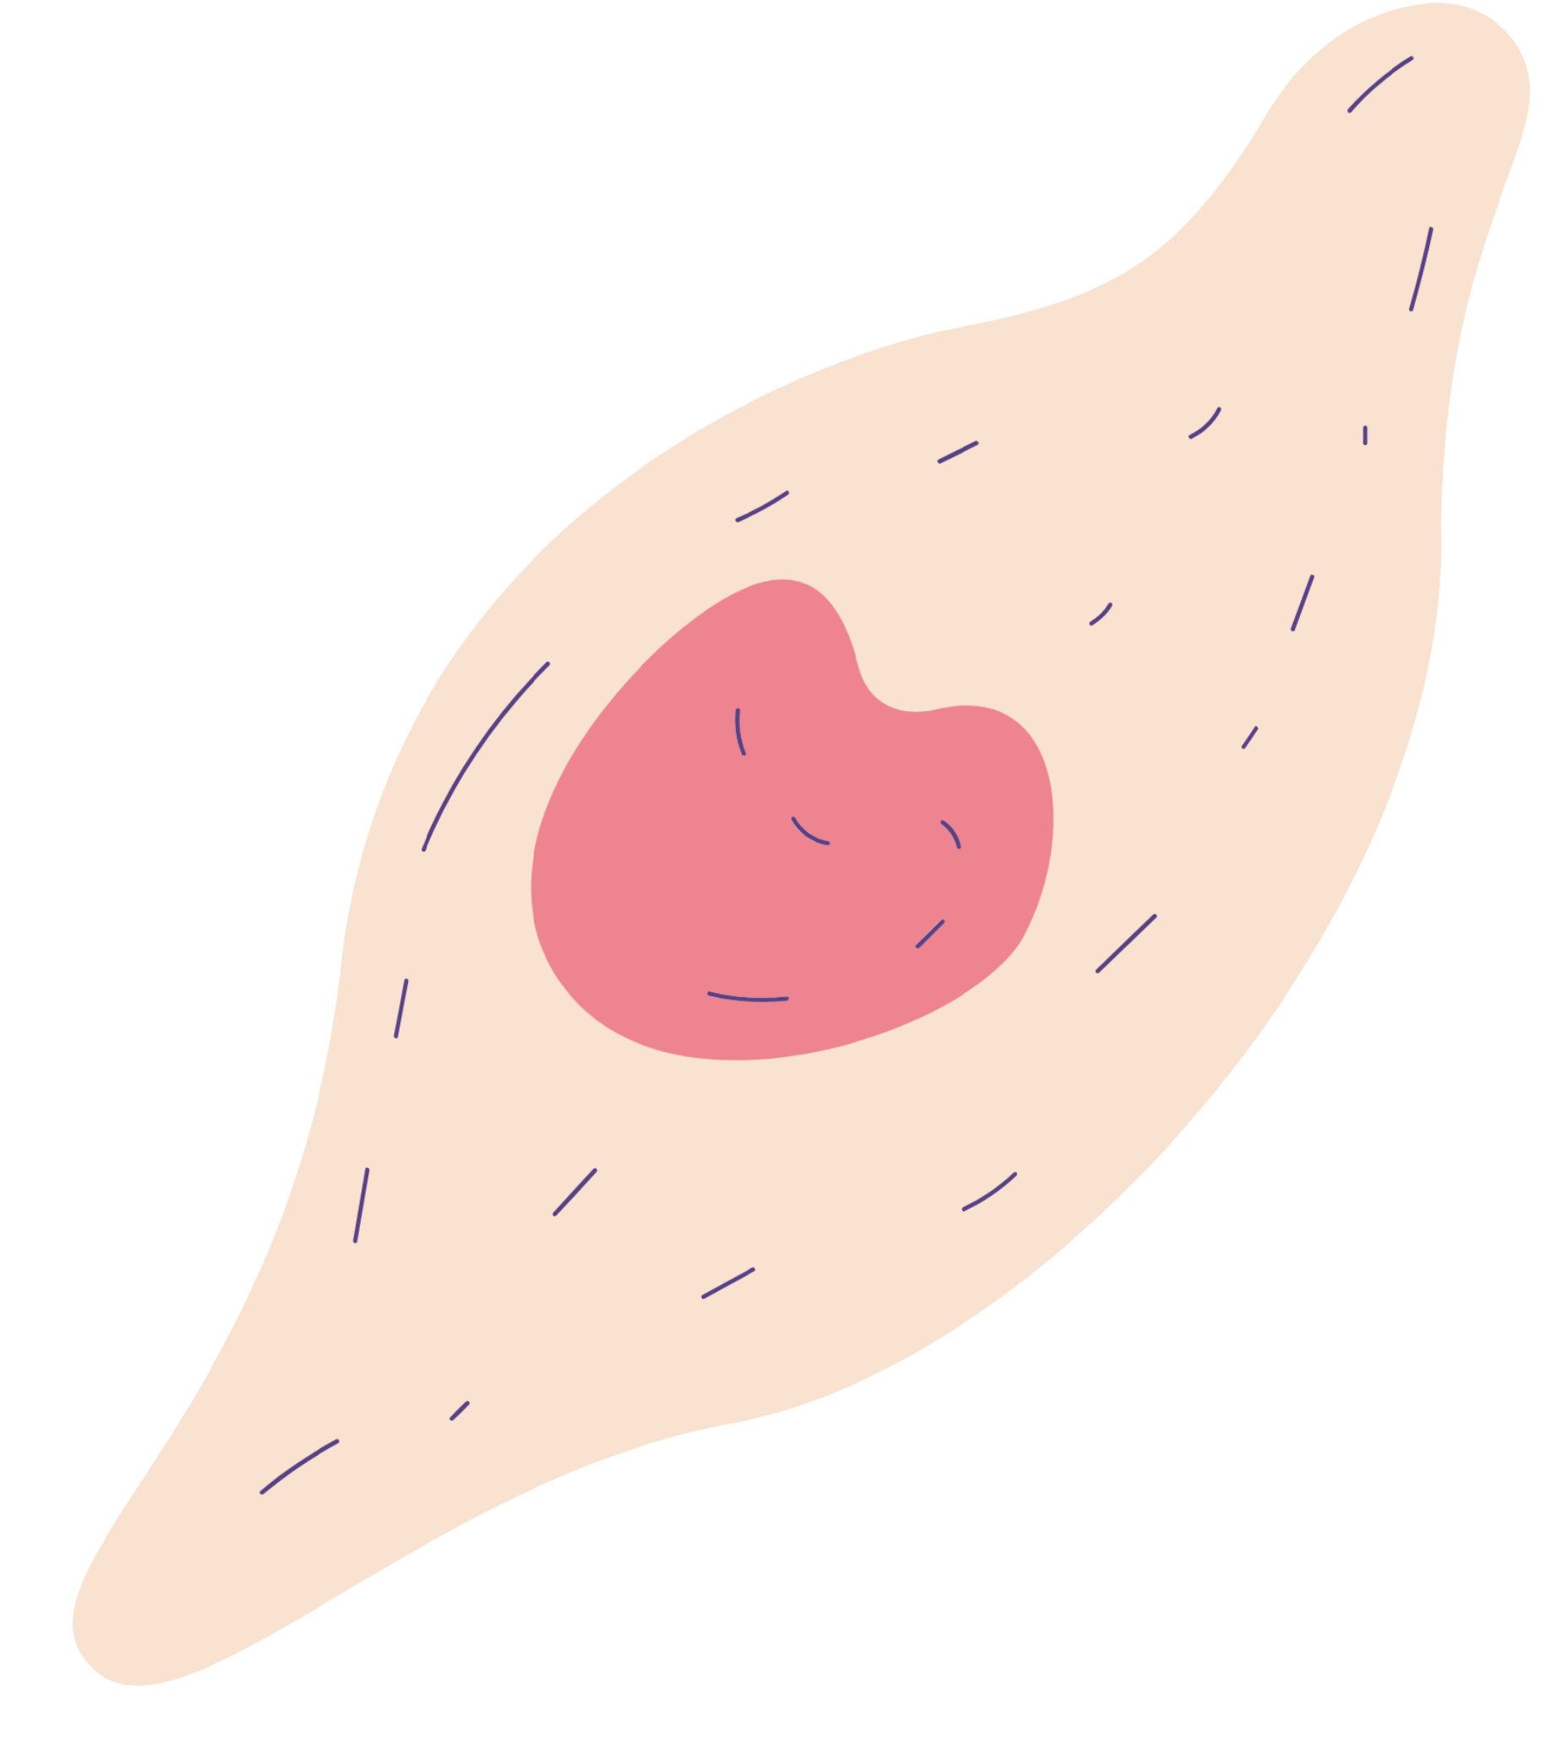
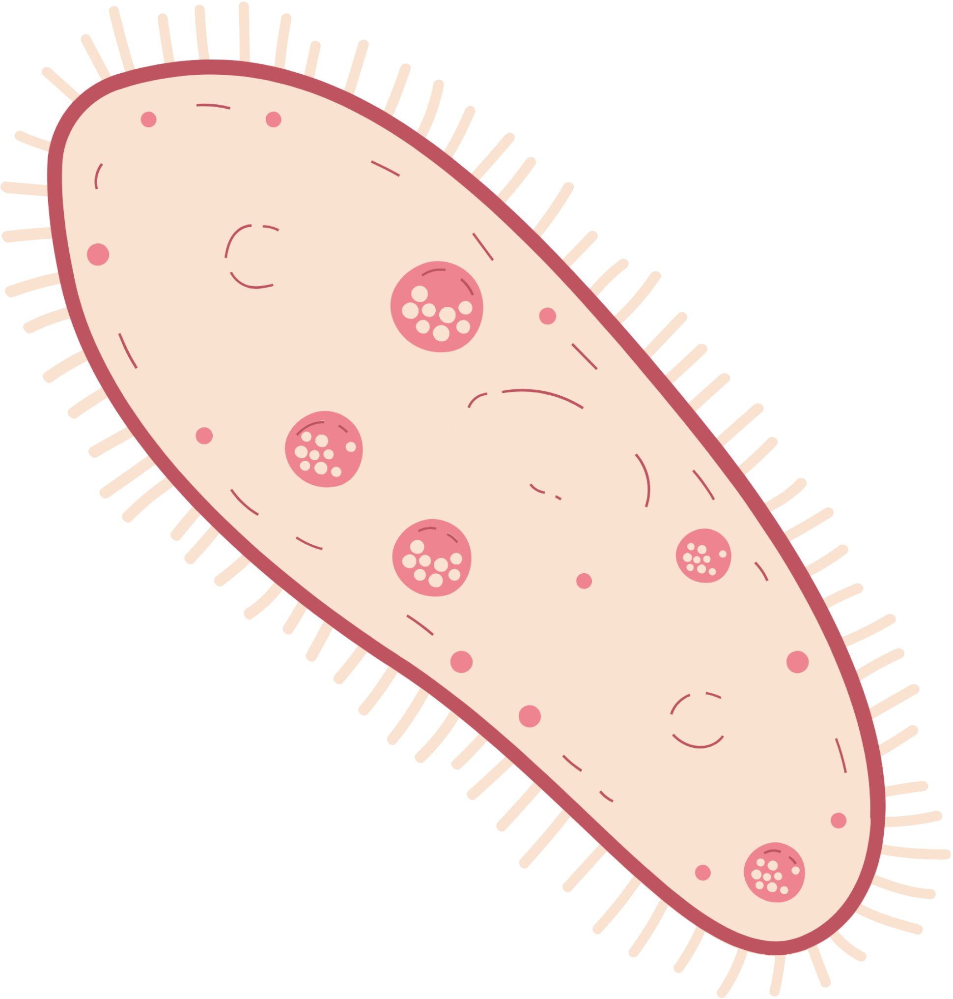

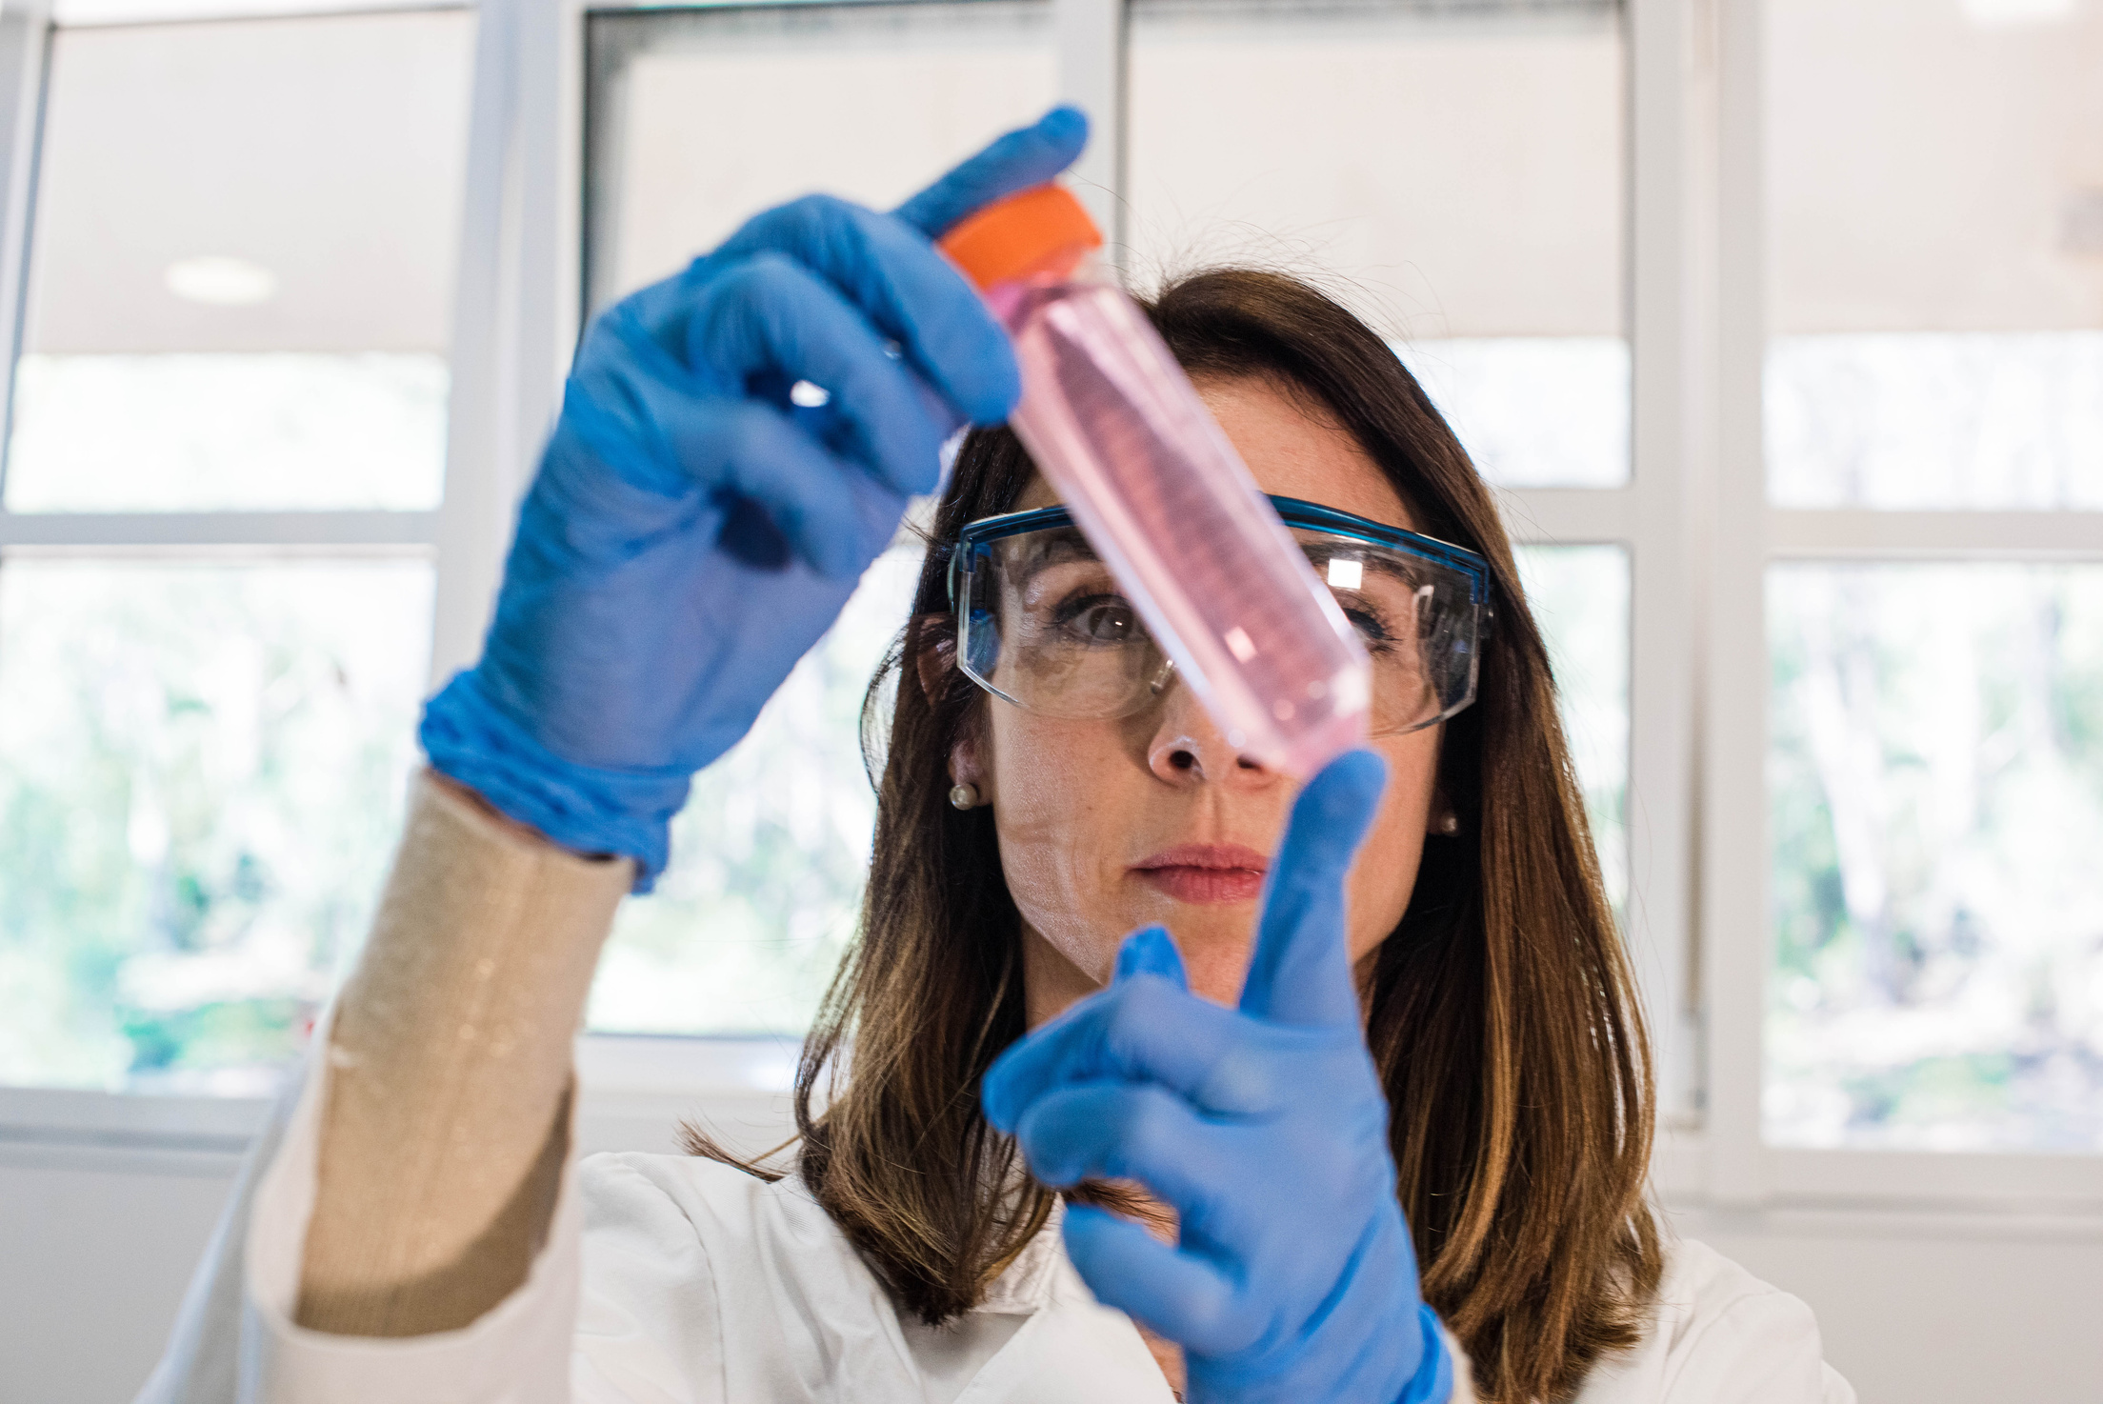
Taxonomy Overview
Phylum: Bacteroidetes
Class: Bacteroidia
Order: Bacteroidales
Family examples: Bacteroidaceae, Prevotellaceae
Key genera: Bacteroides, Prevotella, Parabacteroides

Slide 4
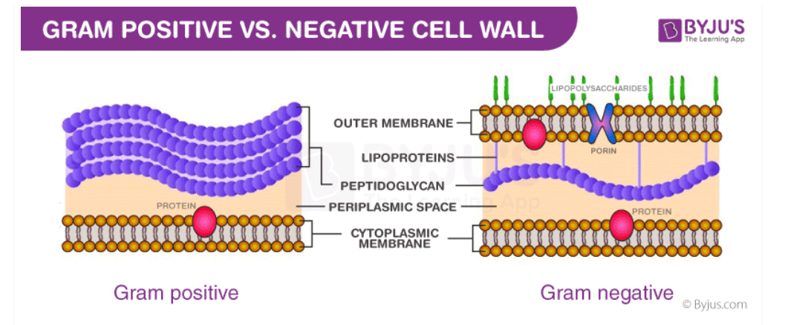
Key Characteristics of Bacteroidetes
Gram positive bacteria have a thick peptidoglycan layer and no outer lipid membrane whilst Gram negative bacteria have a thin peptidoglycan layer and have an outer lipid membrane.

Slide 5
Gram-Positive Bacteria:
Color: Purple
Reason: These bacteria have a thick cell wall made mostly of peptidoglycan. During the staining process, they retain the purple crystal violet dye strongly, so they appear purple under a microscope.
Gram-Negative Bacteria:
Color: Pink or Red
Reason: These bacteria have a thinner peptidoglycan layer and an additional outer membrane. They do not hold onto the purple dye well, so during the process, they lose the purple color but take up a pink or red dye called safranin, which is added as a counterstain.

Slide 6
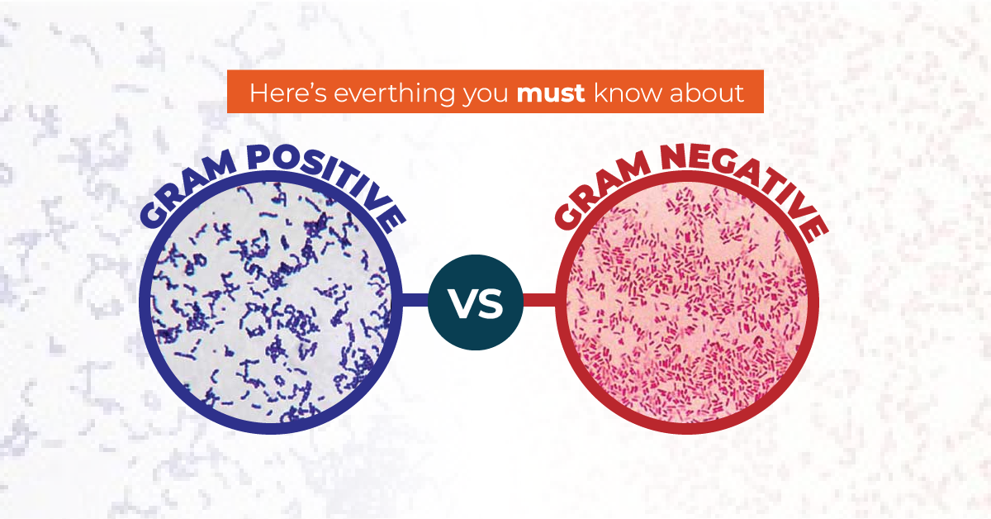
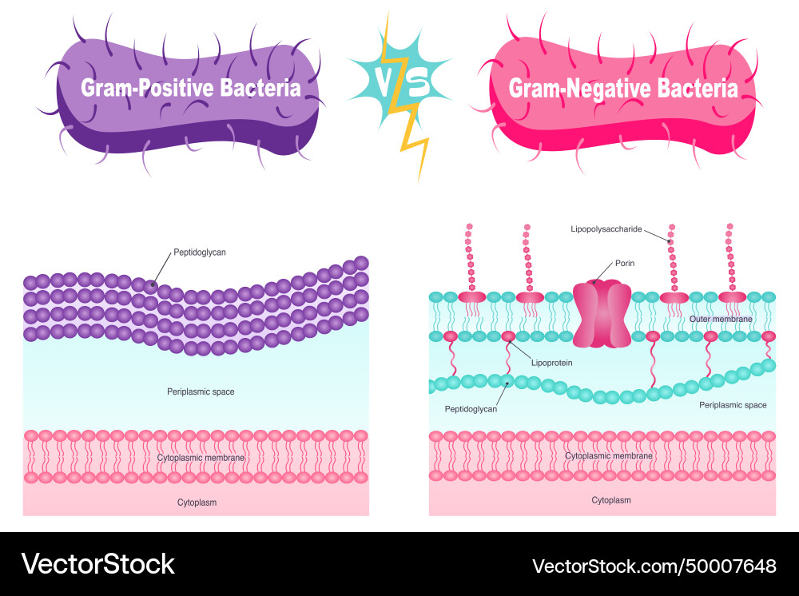

Slide 7
The Gram staining process involves four main steps to differentiate between gram-positive and gram-negative bacteria:
Crystal Violet Stain:
Bacteria on a slide are stained with a purple dye called crystal violet, which enters all bacterial cells, making them purple initially.
Iodine Solution:
An iodine solution is applied, which binds with the crystal violet to form larger complexes inside the cell, helping the dye stick better.
Alcohol Wash (Decolorization):
The slide is rinsed with alcohol (or acetone), which decolorizes the cells. In this step:
Gram-positive cells retain the purple color because their thick peptidoglycan cell wall traps the dye.
Gram-negative cells lose the purple color because their thinner cell wall allows the dye to wash out.

Slide 8
Safranin Counterstain:
A pink or red dye called safranin is added. It stains the gram-negative cells, which appear pink or red under the microscope, while the gram-positive cells remain purple.

Slide 9

Class Bacteroidia
Class Flavobacteriia
Example bacteria
Bacteroides fragilis
Example bacteria:
Flavobacterium johnsniae
Main Classes
Claudia Alves
Class Sphingobacteriia
Example bacteria: Sphingobacterium spiritivorum

Slide 10
Class Bacteroidia
Example bacteria: Bacteroides fragilis
Common in animal guts, especially humans. Important for breaking down complex carbohydrates.

Slide 11
Class Flavobacteriia
Example bacteria:
Flavobacterium johnsniae
Often found in freshwater and marine environments,especially in cold, nutrient-rich waters.

Slide 12
Class Sphingobacteriia
Example bacteria: Sphingobacterium spiritivorum
Associated with soil and plant surfaces. Helps in decomposing plant material, influencing soil fertility.

Slide 13
Ecological Role in the Human Gut
Positive Effects
Aiding Digestion: Bacteroidetes, particularly Bacteroides species, are essential for breaking down complex carbohydrates, proteins, and fats.
Immune System Modulation: Bacteroidetes help the immune system by promoting tolerance to beneficial microbes while preparing it to defend against harmful pathogens.
Preventing Pathogen Colonization: By occupying space and consuming nutrients in the gut, Bacteroidetes help prevent harmful bacteria from establishing and growing.

Slide 14
Ecological Role in the Human Gut
Negative Effects
Opportunistic Infections: While usually beneficial, some Bacteroidetes, like Bacteroides fragilis, can become opportunistic pathogens, especially if they escape the gut (e.g., during surgery or injury).
Association with Diseases:
An imbalance in Bacteroidetes can be linked to diseases. For instance:
Obesity: Low diversity or high levels of certain Bacteroidetes species have been associated with obesity, as some species may increase energy absorption from food.

Slide 15
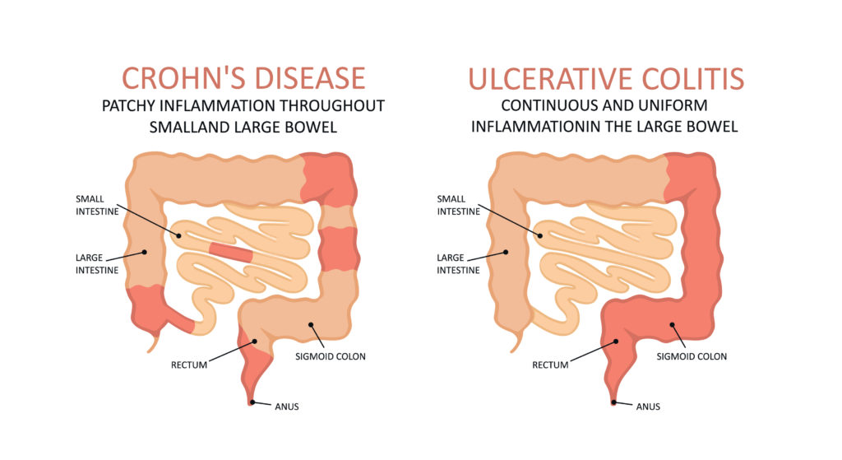
Ecological Role in the Human Gut
Inflammatory Bowel Disease (IBD): An imbalance in Bacteroidetes species can contribute to gut inflammation, aggravating conditions like Crohn's disease and ulcerative colitis.
Potential for Antibiotic Resistance:
Some Bacteroidetes have genes that confer resistance to antibiotics, which they can potentially transfer to other bacteria in the gut.

Slide 16
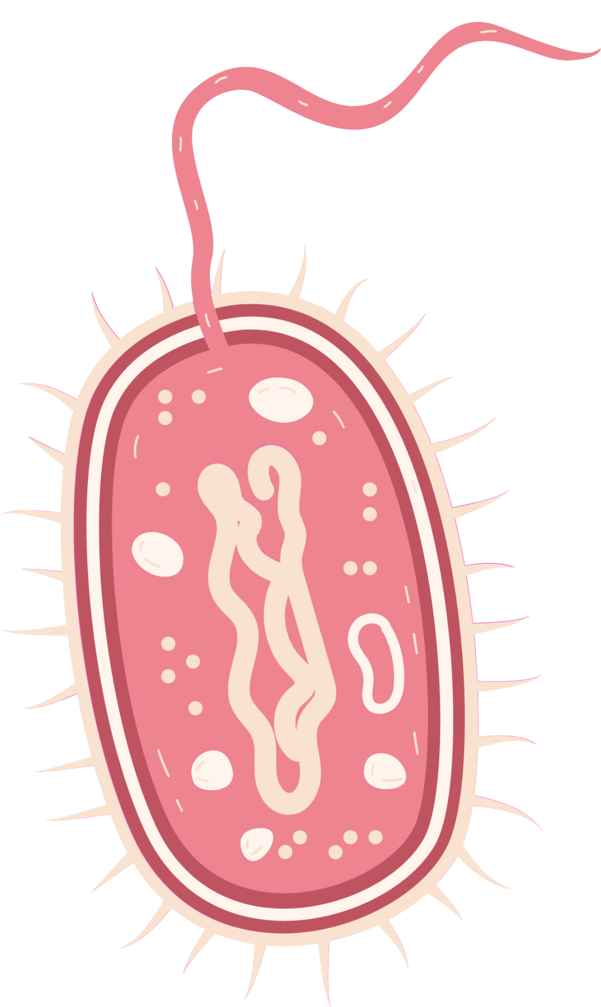

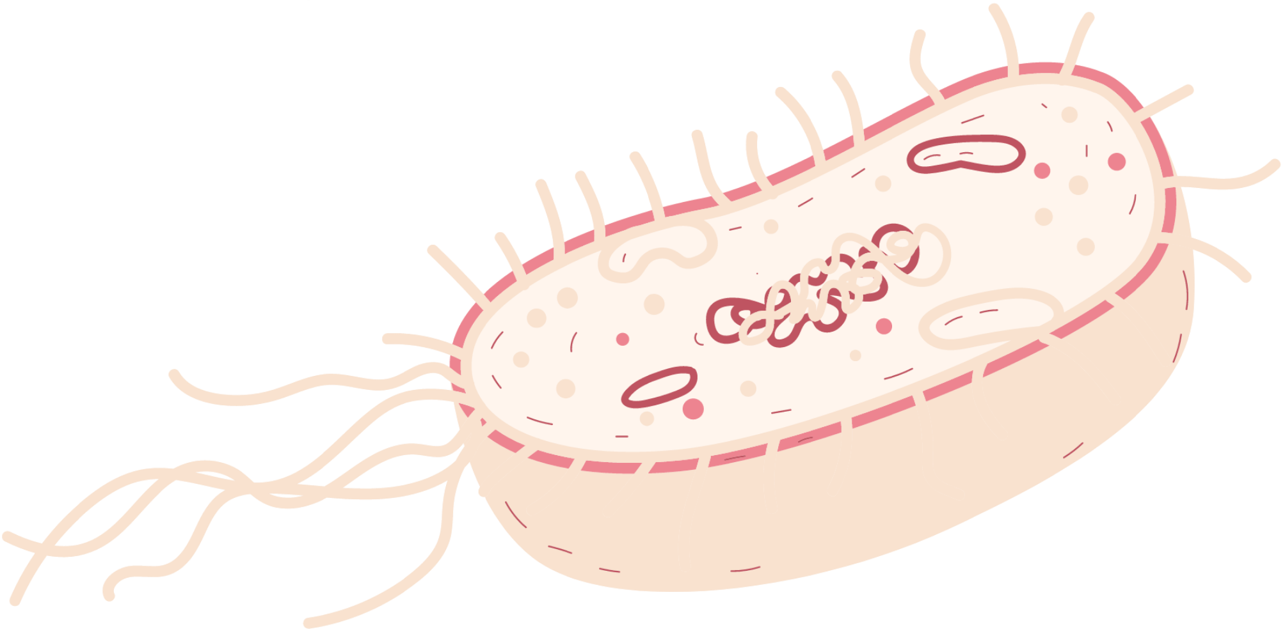
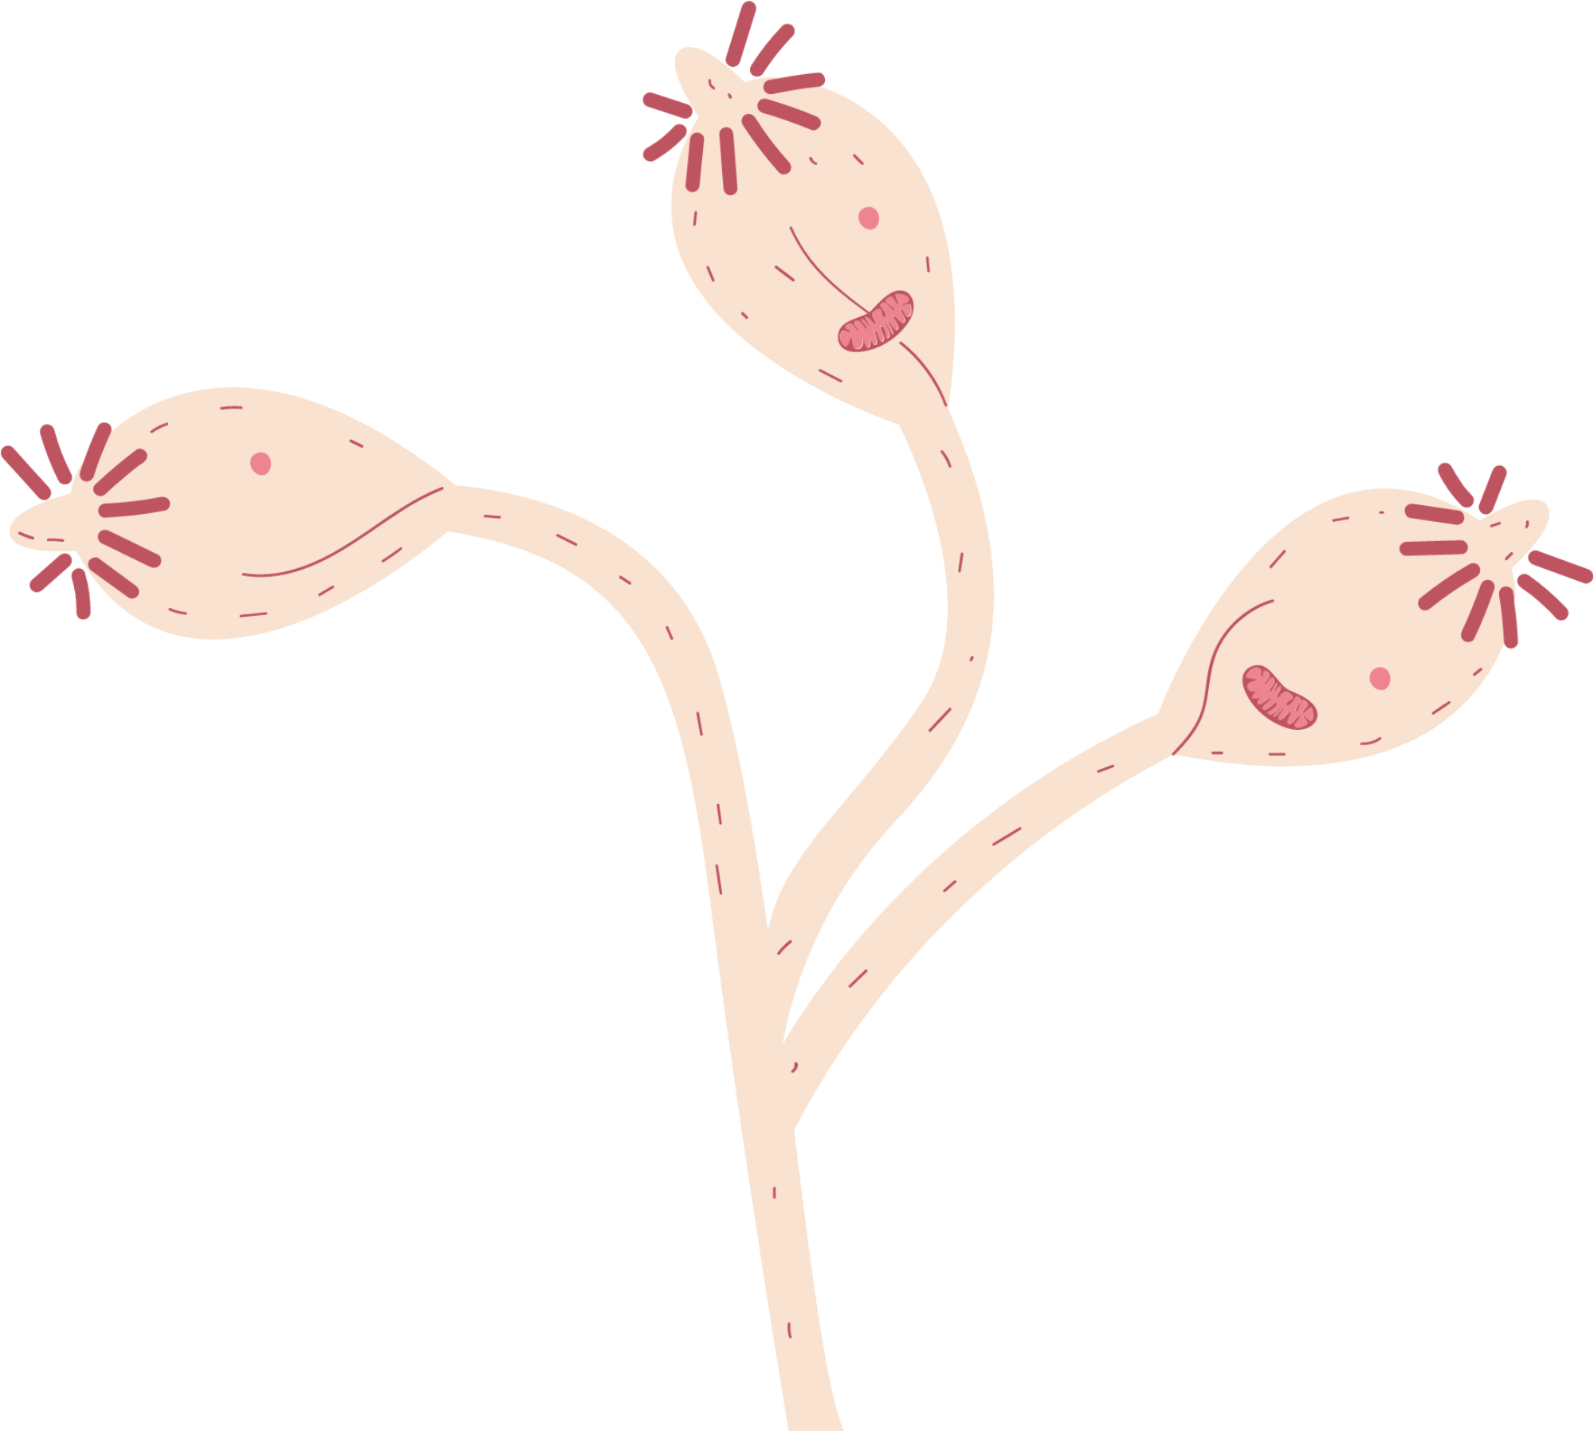
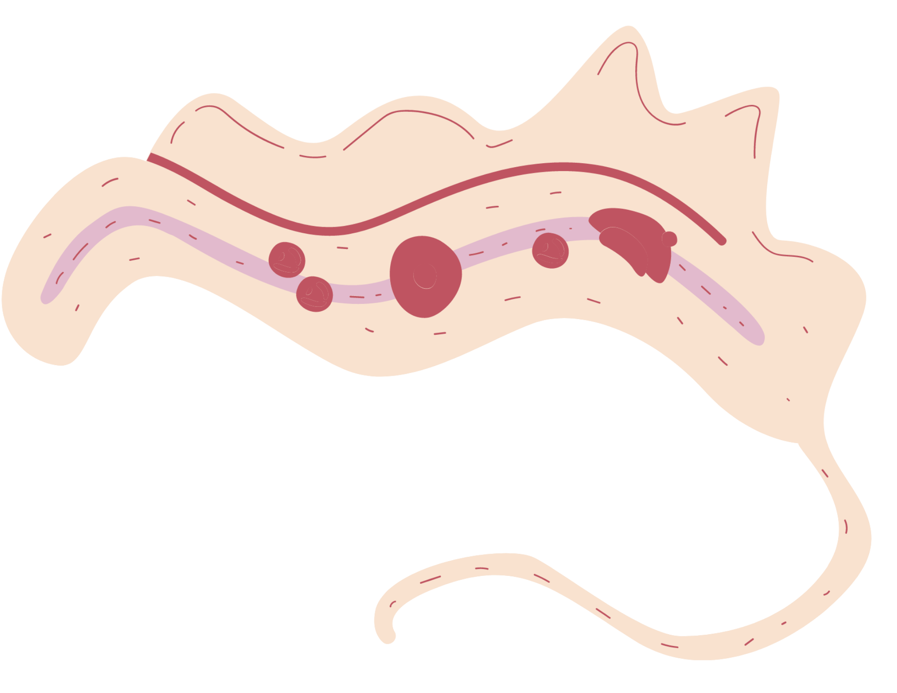
Thank you!

